Slide 1
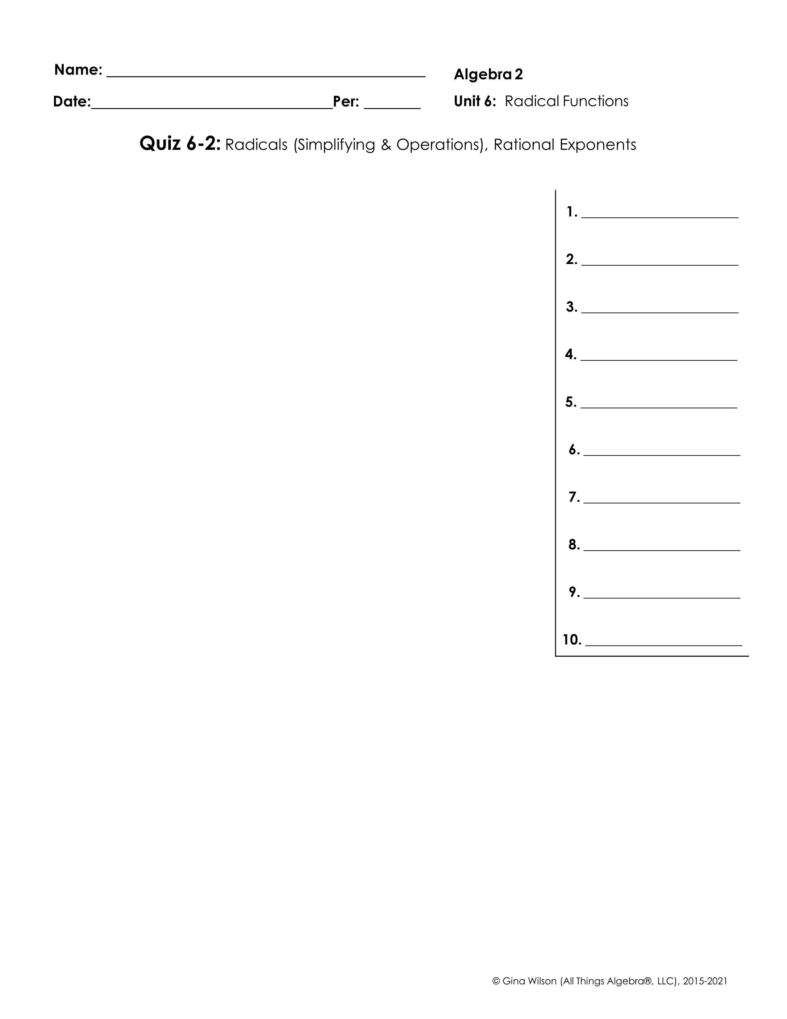
Part I: Radicals – Simplify. Write all final answers in simplest radical form.
1.
2.
3.
4.
5.
6.
7.
8.
9.
10.

Slide 2

11.
12.
13.
14.
Part II: Rational Exponents – Write final answers in simplest radical form.
15.
16.
17.
18.
19.
20.
BONUS:

